Slide 1
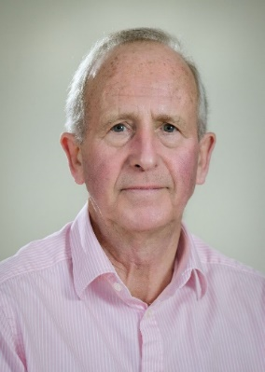
Experimental economics
John Hey
Lecture 12

Slide 2
Dynamic decision-making
Two aspects of dynamic decision problems:
(1) the passage of real time;
(2) sequentiality in decision making.
In this lecture we will look at (2):
Decision, Nature, Decision, Nature...
How do economists perceive individuals as tackling dynamic decision problems?
Many of the experiments discussed here are mine.
Some use pairwise choice, some allocations and some valuations.

Slide 3
Individual dynamic decision-making
Economists assume that individuals solve any dynamic decision problem by backward induction.
DM’s solve the final period, then the penultimate period and so on backwards.
Optimal saving with a given time horizon. Conditional on wealth, the DM takes the best decision in the final period, and then works backwards.
Let us start simple.

Slide 4
Consider the following problem
Green squares are Decision Nodes – at which the subject makes a move.
Red squares are Chance Nodes – at which Nature moves: Up and Down with equal probability and independent of past moves.
The nodes at the end are Payoff Nodes.
You start at the left.

Slide 5
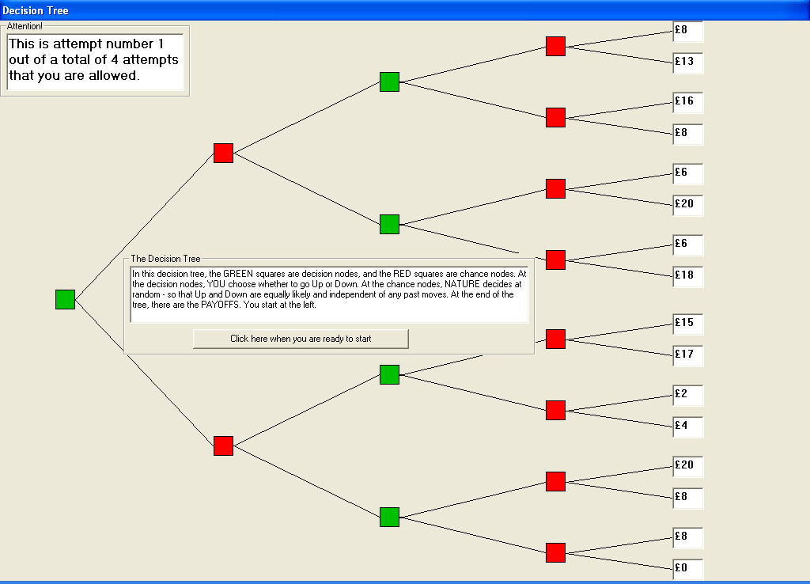

Slide 6
How would YOU tackle this problem?
Economic theory suggests two ways:
The Strategy Method;
Backward Induction.
Both these embody the idea that people PLAN – they think about future moves when deciding on their present moves.
This idea of planning is fundamental to economists’ ways of thinking.

Slide 7
In this example
We will derive the solution by Backward Induction in the lecture.
To derive the solution by the Strategy Method we need some notation for a strategy:
X;YZ means play X (U or D) at first decision node and then play Y(Z) at second decision node if Nature plays U(D)

Slide 8
The Strategy Method
Number | Strategy | Payoffs
1 | U;UU | 8 13 6 20
2 | U;UD | 8 13 6 18
3 | U;DU | 16 8 6 20
4 | U;DD | 16 8 6 18
5 | D;UU | 15 17 20 8
6 | D;UD | 15 17 8 0
7 | D;DU | 2 4 20 8
8 | D;DD | 2 4 8 0

Slide 9
The Strategy Method
Number | Strategy | Payoffs | Ordered
1 | U;UU | 8 13 6 20 | 20 13 8 6
2 | U;UD | 8 13 6 18 | 18 13 8 6
3 | U:DU | 16 8 6 20 | 20 16 8 6
4 | U,DD | 16 8 6 18 | 18 16 8 6
5 | D;UU | 15 17 20 8 | 20 17 15 8
6 | D;UD | 15 17 8 0 | 17 15 8 0
7 | D;DU | 2 4 20 8 | 20 8 4 2
8 | D;DD | 2 4 8 0 | 8 4 2 0
We see that strategy 5 DOMINATES all the others.

Slide 10
The Solution
Backward Induction says that the individual should play Down at the first decision node and then Up at the second – irrespective of what Nature does.
The Strategy Method says the same.
That is because we have organised the payoffs so that they satisfy Dominance.

Slide 11
Planning
Note that both stories involve the idea of planning.
Economic theory relies on this.
So two questions:
Do people plan?
If so, how far ahead do they plan?
At this point we concentrate solely on the first of these.

Slide 12
A way to avoid having to know the subject’s preferences
We carefully constructed the payoffs so that we do not need to know anything about preferences other than they respect dominance: “if one choice dominates another then everyone should choose it”.
Let (a,b) denote a lottery which gives a or b each with probability ½.
We say that “(a,b) dominates (c,d)” (where a≥b and c≥d) if a ≥ c and b ≥ d.
Examples: (£17,£15) dominates (£4,£2)
(£16,£8) dominates (£13,£8)
(£20,£8) dominates (£18,£8)
And so on...

Slide 13
Our experiment uses Dominance (careful calibration)
The four payoffs left after elimination in the bottom half of the tree dominate the four payoffs left after elimination in the top half of the tree. “Down IS better”.
The eight payoffs in the top half of the tree dominate the eight payoffs in the bottom half of the tree. “Up APPEARS better”.
“One route through the tree APPEARS to be best to those who do not plan ahead; a different route IS best (for those who correctly plan ahead).”

Slide 14
An Experiment
Bone J, Hey J D and Suckling J, “Do People Plan”.
Experimental Economics, 2007:
http://www.springerlink.com/content/t2255357v2636605/
This is an accessible paper.
Do read it.

Slide 15
This “3 Johns” experiment
Three treatments – all with (2+2) trees with the dominance property:
Individual;
Pairs;
Individual with pre-commitment¹.
The last one was suggested by a referee and we did not think that it was worth doing – but it was!
¹In this, subjects had to pre-commit to their next move.

Slide 16
Results: individual treatment
Treatment | first attempt |  | second attempt |  | third attempt |  | fourth attempt |  | all attempts
 | cor | inc | cor | inc | cor | inc | cor | inc | cor | inc
Decisions at Second Decision Node
INPC | 52 95% | 3 5% | 54 98% | 1 2% | 54 98% | 1 2% | 54 98% | 1 2% | 214 97% | 6 3%
Decisions at First Decision Node
INPC | 19 35% | 36 65% | 21 38% | 34 62% | 19 35% | 36 65% | 15 27% | 40 73% | 74 34% | 146 66%

Slide 17
Results: pairs treatment
Treatment | first attempt |  | second attempt |  | third attempt |  | fourth attempt |  | all attempts
 | cor | inc | cor | inc | cor | inc | cor | inc | cor | inc
Decisions at Second Decision Node
P | 25 96% | 1 4% | 24 92% | 2 8% | 24 92% | 2 8% | 24 92% | 2 8% | 97 93% | 7 7%
Decisions at First Decision Node
P | 5 19% | 21 81% | 9 35% | 17 65% | 9 35% | 17 65% | 9 35% | 17 65% | 32 31% | 72 69%

Slide 18
Results: individual pre-commitment treatment
Treatment | first attempt |  | second attempt |  | third attempt |  | fourth attempt |  | all attempts
 | cor | inc | cor | inc | cor | inc | cor | inc | cor | inc
Decisions at Second Decision Node
IPC | 43 96% | 2 4% | 41 91% | 4 9% | 44 98% | 1 2% | 40 89% | 5 11% | 168 93% | 12 7%
Decisions at First Decision Node
IPC | 13 29% | 32 71% | 14 31% | 31 69% | 15 33% | 30 67% | 18 40% | 27 60% | 60 33% | 120 67%

Slide 19
Results: all treatments
Treatment | first attempt |  | second attempt |  | third attempt |  | fourth attempt |  | all attempts
 | correct | incorrect | correct | incorrect | correct | incorrect | correct | incorrect | correct | incorrect
Decisions at Second Decision Node
INPC | 52 95% | 3 5% | 54 98% | 1 2% | 54 98% | 1 2% | 54 98% | 1 2% | 214 97% | 6 3%
IPC | 43 96% | 2 4% | 41 91% | 4 9% | 44 98% | 1 2% | 40 89% | 5 11% | 168 93% | 12 7%
P | 25 96% | 1 4% | 24 92% | 2 8% | 24 92% | 2 8% | 24 92% | 2 8% | 97 93% | 7 7%
Decisions at First Decision Node
INPC | 19 35% | 36 65% | 21 38% | 34 62% | 19 35% | 36 65% | 15 27% | 40 73% | 74 34% | 146 66%
IPC | 13 29% | 32 71% | 14 31% | 31 69% | 15 33% | 30 67% | 18 40% | 27 60% | 60 33% | 120 67%
P | 5 19% | 21 81% | 9 35% | 17 65% | 9 35% | 17 65% | 9 35% | 17 65% | 32 31% | 72 69%

Slide 20
Conclusions so far
Even forcing them to think about their future moves along the branch they choose does not force them to think what they might do if they chose differently.
More experiments:
Simpler trees (2+1 or 1+2);
Complete strategy.
Many people do not seem to plan.

Slide 21
Types
Let us now look from a different perspective – looking at the types of behaviour:
Resolute
Naïve
Sophisticated

Slide 22
Two Problems: what would you choose – Up or Down – in each?
Note: green squares are decision
nodes and red squares are chance
nodes.
£30
first
0.25
£30
second
£50
0.8
0.75
£0
0.2
£0
£50
0.2
0.8
£0
Consider a person who violates EU, choosing Up in the first problem and Down in the second.

Slide 23
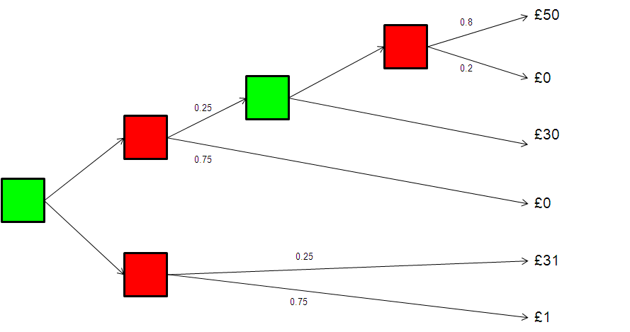
What does such a person do in this dynamic problem? Suppose that he/she prefers £30 to the 80% chance of £50 and that he/she strictly prefers the 20% chance of £50 to the 25% chance of £30 (and hence to a 25% chance of £31 and a 75% chance of £1).
Note: green squares are decision nodes and red squares are chance nodes.

Slide 24
What they do depends on their type
Resolute: Choose Up at the first and Up at the second (even though they want to choose Down when they get there).
Naive: Choose Up at the first and Down at the second.
Sophisticated: Choose Down at the first (because they anticipate moving Down at the second if they choose Up at the first). The latter is what is assumed when backward induction is used.

Slide 25
Our first attempt was with Allocations
Hey and Pannacione, “Dynamic decision making: what do people do?”, Journal of Risk and Uncertainty, 42, 85-123, 2011.
In two stages subjects have to allocate tokens (convertible into money) between two options.
I have been unable to load the software onto the site.
But I have it on a USB stick and I could let anyone have it.

Slide 26
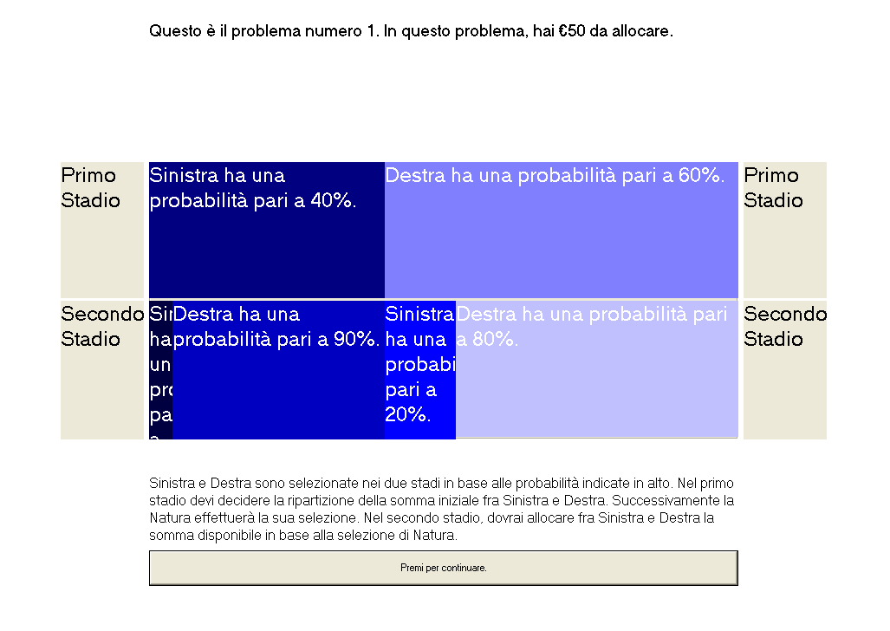

Slide 28
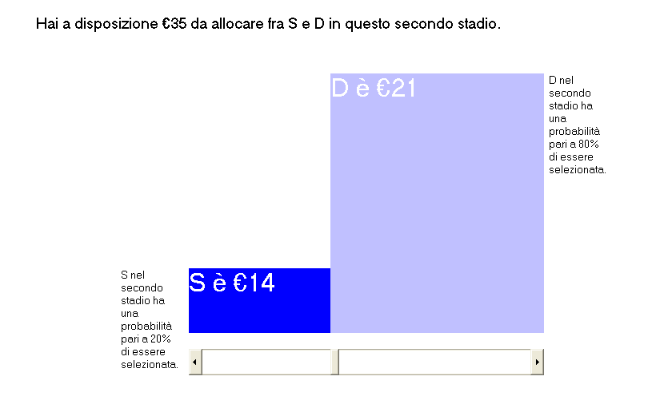

Slide 29
Types
Resolute: Takes a decision at the first node and then implements it.
Naive: Takes a decision at the first node and may change his or her mind at the second.
Sophisticated: Anticipates his or her decision at the second node and takes that into account when choosing at the first node.
Myopic (a new type): Treats the first decision as the final decision. In other words, ignores the second decision when taking the first.

Slide 30
Estimation
We fitted preference functionals to the data, assuming a particular utility function (CRRA) and estimating the parameters.
We found for each type the best-fitting functional and hence the maximised log-likelihood.
We chose the best type on the basis of the maximised log-likelihood.
Note: we have to assume a non-EU preference functional for otherwise all types are the same.
We assumed Rank Dependent EU (with a probability weigting function).

Slide 31
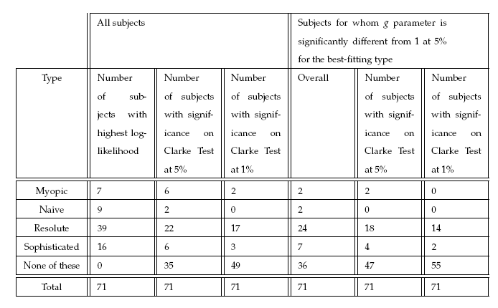
A summary of the main results

Slide 32
Conclusions
The bottom line is that the majority of our dynamically inconsistent subjects are resolute, a significant minority are sophisticated; and rather few are naive or myopic.
Software encouraged this? We think not.
Extensions: (1) more and more representative subjects; (2) more stages.

Slide 33
Hey and Lotito
“Naive, resolute or sophisticated? A study of dynamic decision making” JRU 2009.
Here we looked at decisions as well as valuations.
We exposed our subjects to 12 trees and asked them to take decisions as well as value the trees. (2nd price sealed bid)
We find that the majority of subjects are either naive or resolute (with slightly more being naive) but very few are sophisticated.
To run the software click here and then click on trees.exe

Slide 34
An extension
See Hey and Knoll, Journal of Economic Psychology 2011.
Once again, I have been unable to load the software onto the site.
But I have it on a USB stick and I could let anyone have it.

Slide 35
Hey and Knoll
This is a complicated decision problem and difficult software.
We are trying to see if people plan their way through a tree.
Our analysis is driven by psychology.

Slide 36
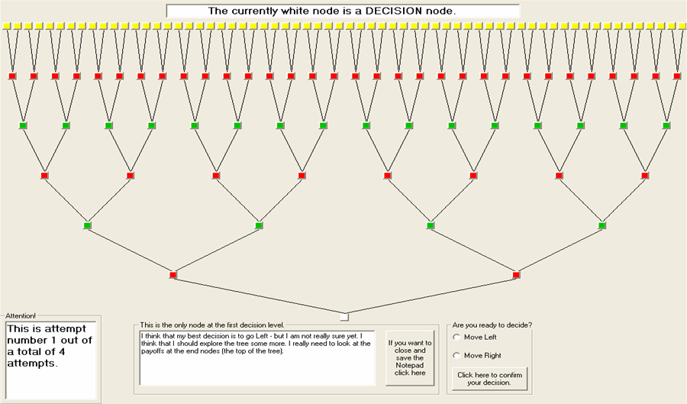
The decision tree
payoff nodes
decision node
chance node
notepad

Slide 37
Dominance Property of the Payoffs
8 13 16 8 6 20 6 18
15 17 2 4 20 8 8 0
left
20 18 16 13 8 8 6 6
left dominates right
subject may move left
right
20 17 15 8 8 4 2 0
left
20 16 8 6
right dominates left
subject may move right
right
20 17 15 8
different paths for different planning horizons

Slide 38
Conduct of the Experiment
EXEC, University of York
92 subjects
individually & at their own speed
instructions:
written
power point
questions
4 attempts with the same set of payoffs
payment:
payoff on each attempt → 4 payoffs
final payoff randomly chosen out of those 4 payoffs

Slide 39
The observed Decision Strategies
Effort Minimizer / Ignorants
Backward Inducters
Rationalists
Quasi- Rationalists
Simplifier
Desperates
Effort & Time Savers
Forward Worker
Strategy Mixers
Strategy mixer
11%
Forward Workers
34%
24%
Effort Minimizer
16%
3%
12%
Simplifier
Quasi- Rationalists
Rationalists

Slide 40
The Decision Strategies Effort Minimizer / Ignorants
do not check payoffs at all or checked payoffs arbitrarily but ignored this information
few subjects: wrong decision on DL3 although they have checked the remaining two payoffs before
some did not understand the task
Instructions
Hypothesis testing
very fast
almost no cognitive effort
26 subjects (24%)
cost-benefit analysis

Slide 41
The Decision Strategies Overview We very much followed the psychologists approach.
Effort Minimizer / Ignorants
Backward Inducters
Rationalists
Quasi- Rationalists
Simplifier
Desperates
Effort & Time Savers
Forward Worker
Strategy Mixers
Strategy mixer
11%
Forward Workers
34%
24%
Effort Minimizer
16%
3%
12%
Simplifier
Quasi- Rationalists
Rationalists

Slide 42
The Decision Strategies Backward Inducters: Overview
Different degrees of Backward Induction
three subgroups with different degrees of rational decision behaviour
in common: tackle the decision problem backwards
29 Backward Inductors (31%)
Rationalists: 11 subjects (12%)
Quasi-Rationalists: 3 subjects (3%)
Simplifier: 15 subjects (16%)

Slide 43
The Decision Strategies Overview
Effort Minimizer / Ignorants
Backward Inducters
Rationalists
Quasi- Rationalists
Simplifier
Desperates
Effort & Time Savers
Forward Worker
Strategy Mixers
Strategy mixer
11%
Forward Workers
34%
24%
Effort Minimizer
16%
3%
12%
Simplifier
Quasi- Rationalists
Rationalists

Slide 44
The Decision Strategies Backward Inducters: The Rationalists
top-down
starting point DL3
either make a decision for every decision node on DL3
or note the corresponding payoffs in the notepads on DL3 without a decision and infer the right decision from this entries for DL2
21 decisions
some subjects use BI from the beginning
Experience?
others work this strategy out
recheck notepad entries
make corrections

Slide 45
The Decision Strategies Overview
Effort Minimizer / Ignorants
Backward Inducters
Rationalists
Quasi- Rationalists
Simplifier
Desperates
Effort & Time Savers
Forward Worker
Strategy Mixers
Strategy mixer
11%
Forward Workers
34%
24%
Effort Minimizer
16%
3%
12%
Simplifier
Quasi- Rationalists
Rationalists

Slide 46
The Decision Strategies Backward Inducters: The Quasi-Rationalists
top-down
almost the same decision behaviour as ‘Rationalists’
BUT: mistake on DL2
take irrelevant information into account when inferring the decision for DL1
only 3 subjects (3%)
do not know how to further reduce the information ?
lack of attention / cognitive exhaustion ?

Slide 47
The Decision Strategies Overview
Effort Minimizer / Ignorants
Backward Inducters
Rationalists
Quasi- Rationalists
Simplifier
Desperates
Effort & Time Savers
Forward Worker
Strategy Mixers
Strategy mixer
11%
Forward Workers
34%
24%
Effort Minimizer
16%
3%
12%
Simplifier
Quasi- Rationalists
Rationalists

Slide 48
The Decision Strategies Backward Inducters: Simplifier – the desperates
top-down
backward induct the optimal decision until DL2
get stuck on DL2
apparently do not know how to further reduce the information
bottom-up: take a ‘random’ decision on DL1
… subjects (… %)

Slide 49
The Decision Strategies Backward Inducters: Simplifier – Effort & Time Savers
first decision bottom-up
made on DL1
number of decisions reduced to 6
remaining decisions top-down
backward induct the optimal decisions for the remaining branches
... subjects (…%)

Slide 50
The Decision Strategies Overview
Effort Minimizer / Ignorants
Backward Inducters
Rationalists
Quasi- Rationalists
Simplifier
Desperates
Effort & Time Savers
Forward Worker
Strategy Mixers
Strategy mixer
11%
Forward Workers
34%
24%
Effort Minimizer
16%
3%
12%
Simplifier
Quasi- Rationalists
Rationalists

Slide 51
The Decision Strategies Forward Worker
bottom-up
check (most of the) 64 payoffs
make a move on DL1
check the remaining 16 payoffs
make a move on DL2
check the remaining 4 payoffs
make a move on DL3
no decision is taken in advance!
decisions will only be made when subjects get to a decision node
31 subjects (34%)

Slide 52
The Decision Strategies Forward Worker: different groups
Decision Level 1
F1
subjects with a specific decision criterion for DL1
F2
subjects who change their decision criterion or work one out for DL1
F3
subjects with no decision criterion for DL1
consistent decision on every attempt
heuristics:
avoid zero
avoid small outcomes
cut-off criteria
maximum total sum of payoffs
systematic change of the decision criterion
seem to be aware that their decisions are suboptimal
look for an improvement
apparently arbitrary changes of the first decision
some try to randomize

Slide 53
The Decision Strategies Overview
Effort Minimizer / Ignorants
Backward Inducters
Rationalists
Quasi- Rationalists
Simplifier
Desperates
Effort & Time Savers
Forward Worker
Strategy Mixers
Strategy mixer
11%
Forward Workers
34%
24%
Effort Minimizer
16%
3%
12%
Simplifier
Quasi- Rationalists
Rationalists

Slide 54
The Decision Strategies Strategy Mixers
subjects use different strategies
either within the attempt
between the attempts
or within and between the attempts
could not be assigned unequivocally to one of the groups
10 subjects (11%)
guessing
take in new information → changes preferences

Slide 55
Other extensions
The passage of real time – discounting.
Savings problems.

Slide 56
Conclusions
What have we learnt?
Human beings do not use Backward Induction.
Too complicated or too time-consuming?
Perhaps they know what they should be doing, but could not be bothered to implement it?
Perhaps we should have told them about the dominance property?
Perhaps it was a bad experiment.

Slide 57
That is the end of Lecture 12…
… on dynamic decision-making.
A complicated story, from a theory point of view, and difficult for subjects to solve.

